Slide 1


Appointment booking and Management System
Aniket Giriyalkar
giriyalkar.aniket@gmail.com

Slide 2


Features implemented
Appointment Lists: Shows the list of appointments, time and appointment notes.
Add Appointment: Allows to add appointment details using a form and the submitted ones appear in the list
Searching and Filters: Allows to search based keys and allows the option for sorting in two directions. Uses a dropdown for this functionality.

Slide 3
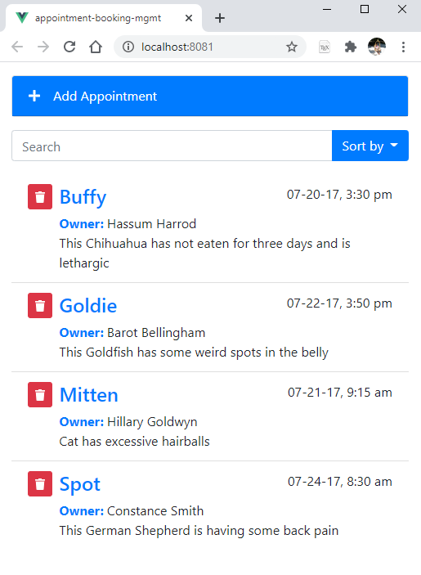
Appointment List
This displays the list of all the appointments that reside in the application.
By default all the appointments are displayed based on the PetName filter sorted in Ascending order.
We can also delete an item from the Appointment list just by clicking the Delete Icon.

Slide 4
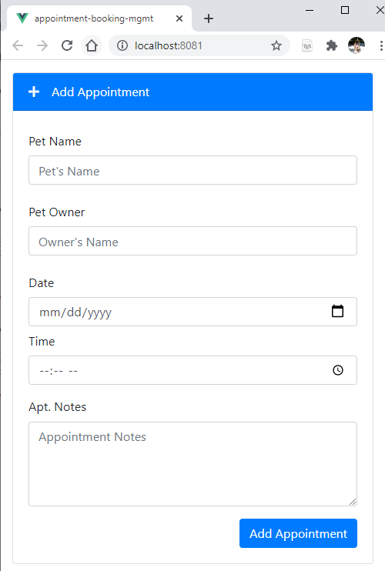
Add Appointment
Add appointment button is a toggle which on clicked shows a form.
After filling in the information and submitting the item added shows up in Appointments list.
On submitting the toggle goes back to not displaying the form and all the form elements are set to empty.(see Demo)

Slide 5
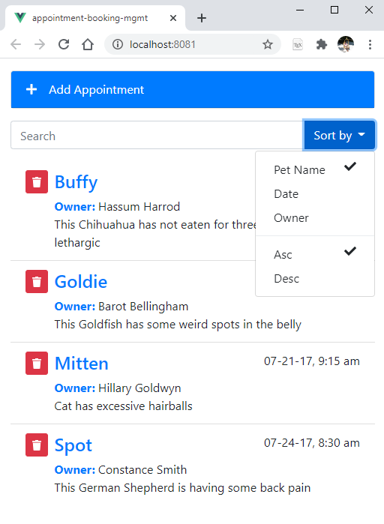
Searching & Filters
We have a search bar in which we enter the term we want to search.
The dropdown consists of checkboxes which contain the filters like Pet Name, Date and Owner and sort orders asc and desc which we can select.
We can perform the search based on one key filter in either ascending or descending order.(see Demo)

Slide 6

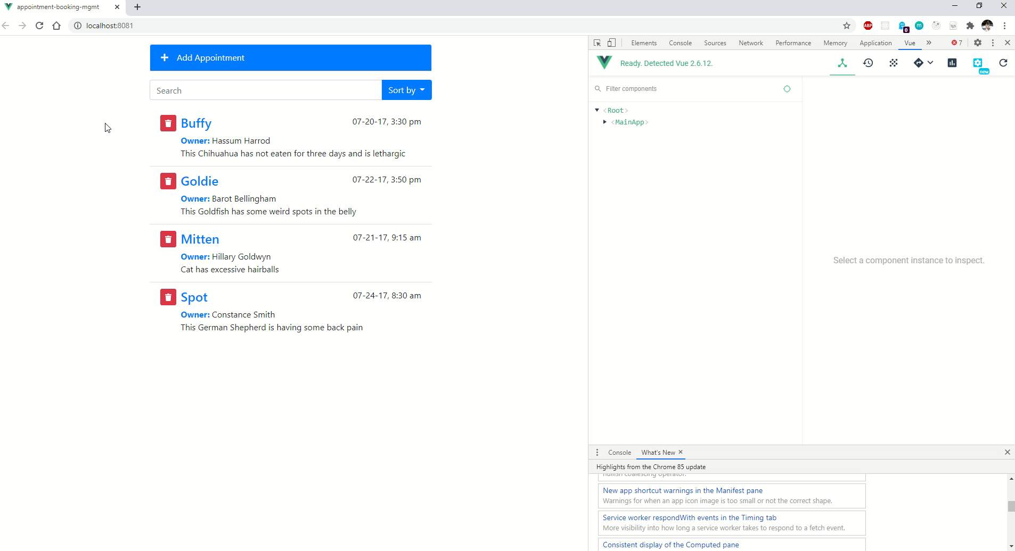

Video Demo

Slide 7

Thank You

